Slide 1
Chapter 13 Organisms And Populations

Slide 2
Objectives of the chapter
To explore ecology at organismic levels.
To explore ecology at population levels.

Slide 3
Biology (Tells about interaction of among organisms and physical habitats as a group)
Classical biology
Modern biology
(molecular aspects of biology)
Ecology
(unites biological information into a unifying principle)
Botany
Zoology
Branch of biology which studies the interaction among organisms and between the organism and its physical/abiotic environment, studies anthropogenic environmental degradation, the socio-political issues, etc
Gives holistic perspective to biology

Slide 4
Different questions comes in our mind about fascinatingly diverse (Biodiversity) and amazingly complex
How does the bird sing?
Why does the bird sing?
Why are night-blooming flowers generally white?
How does the bee know which flower has nectar?
Why does cactus have so many thorns?
How does the chick recognise her own mother?

Slide 5
Biology helps in understanding complexity of biodiversity by investigating processes at various levels of biological organisation
Macromolecules
Cells
Tissues
Organs
Individual organisms
Population
Communities
Studied in Ecology
Ecosystems
Biomes*
*A large naturally occurring community of flora and fauna occupying a major habitat, e.g. forest or tundra.

Slide 6
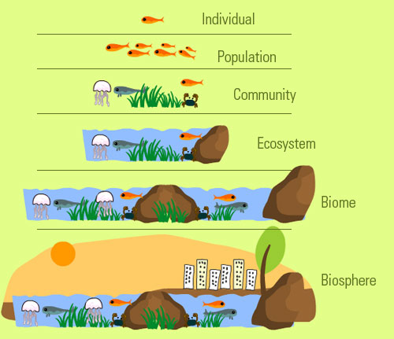

Slide 7
Ecology at organismic level
Ecology at the organismic level is essentially physiological ecology
Ecology at organismic level tries to understand how different organisms are adapted to their environments in terms of not only survival but also reproduction.
What is the cause of annual variations in the intensity and duration of temperature?
Cause of annual variations in the intensity and duration of temperature, resulting in distinct seasons is
rotation of our planet around the Sun and the tilt of its axis
What are the factors affecting the formation of major biomes like desert, rain forest and tundra?
Factors affecting the formation of major biomes such as desert, rain forest and tundra
Intensity and duration of temperature, resulting in distinct seasons.
Annual variation in precipitation (both rain and snow)
Regional and local variations within each biome lead to the formation of a wide variety of habitats.
On planet Earth, life exists everywhere
favourable habitats
extreme and harsh habitats –scorching Rajasthan desert, perpetually rain-soaked Meghalaya forests, deep ocean trenches, torrential streams, permafrost polar regions, high mountain tops, boiling thermal springs, and stinking compost pits, to name a few.
intestine

Slide 8
Biology helps in understanding complexity of biodiversity by investigating processes at various levels of biological organisation
Macromolecules
Cells
Tissues
Organs
Individual organisms
Population
Communities
Studied in Ecology
Ecosystems
Biomes*
*A large naturally occurring community of flora and fauna occupying a major habitat, e.g. forest or tundra.

Slide 9
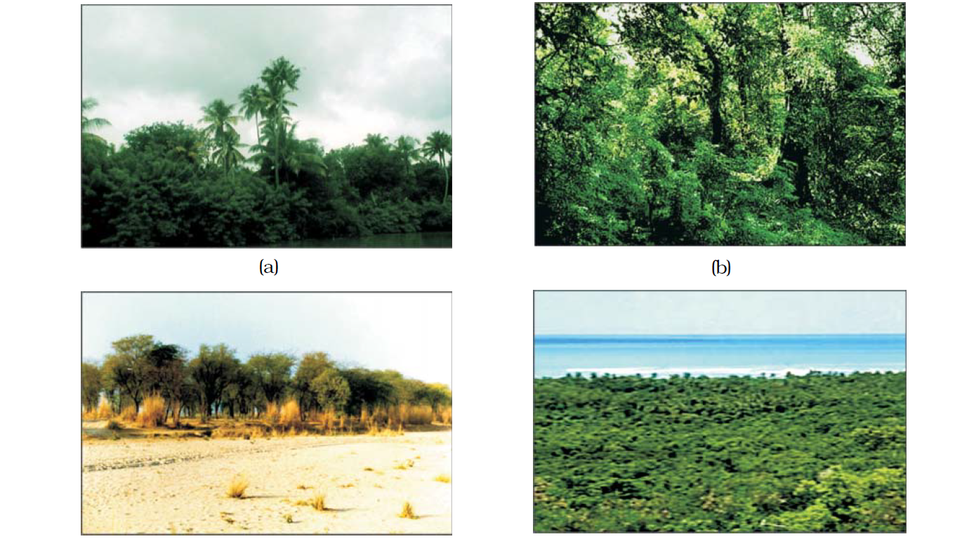
Major biomes of India.
Tropical rain forest
Deciduous forest
Desert
Sea coast

Slide 10
Figure Biome distribution with respect to annual temperature and precipitation
30
Grassgland
Tropical forest
25
Desert
20
Temperate forest
15
10
Mean annual temperature (℃)
5
Coniferous forest
0
-5
Arctic and Alpine tundra
-10
-15
50
100
150
200
250
300
350
400
450
Mean annual precipitation (cm)

Slide 11
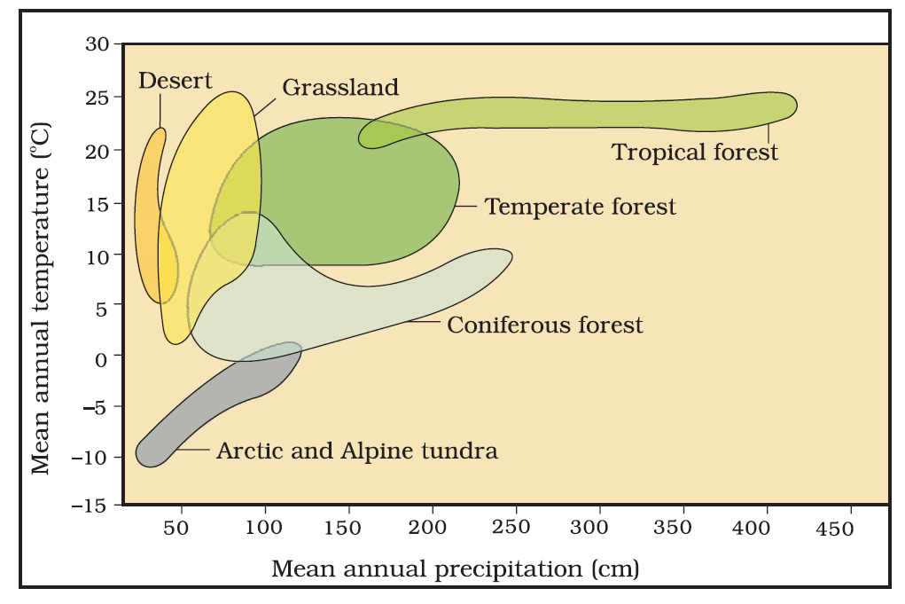
Figure Biome distribution with respect to annual temperature and precipitation

Slide 12
Environment (Habitat of organism)
Physico-chemical components
or
Abiotic factors
Biotic components
(pathogens, parasites, predators and competitors)
Soil
Light
Temperature
Water
Key elements that lead to variation in the physical and chemical conditions of different habitats
Organism evolve through natural selection
Adaptations in organism’s habitat optimised its survival and reproduction

Slide 13
Temperature as a major abiotic factor
Temperature is the most ecologically relevant environmental factor.
The average temperature on land varies seasonally, decreases progressively from the equator towards the poles and from plains to the mountain tops.
Temperature ranges from subzero levels in polar areas and high altitudes to >50 ºC in tropical deserts in summer.
Unique habitats such as thermal springs and deep-sea hydrothermal vents where average temperatures exceed 100 ºC.
It is general knowledge that mango trees do not and cannot grow in temperate countries like Canada and Germany, snow leopards are not found in Kerala forests and tuna fish are rarely caught beyond tropical latitudes in the ocean.

Slide 14
Temperature as a major abiotic factor
Temperature affects the kinetics of enzymes and through it the basal metabolism, activity and other physiological functions of the organism.
Eurythermal organisms can tolerate and thrive in a wide range of temperatures
Stenothermal organisms survive in restricted narrow range of temperatures
The levels of thermal tolerance of different species determine to a large extent their geographical distribution.
Global warming (increasing average global temperatures) affect the distributional range of some species

Slide 15
Water as a major abiotic factors
Water is the most important factor influencing the life of organisms.
In fact, life on earth originated in water and is unsustainable without water.
Water availability is so limited in deserts that only special adaptations make it possible to live there.
The productivity and distribution of plants is also heavily dependent on water.
For survival of aquatic organisms the quality (chemical composition, pH) of water becomes important.
The salt concentration of aquatic body is measured as salinity in parts per thousand.
Salinity is <5 per cent in inland waters, 30-35 per cent the sea and >100 per cent in some hypersaline lagoons.
Euryhaline organisms are tolerant of a wide range of salinities
Stenohaline are restricted to a narrow range of salinities.
Many freshwater animals cannot live for long in sea water and vice versa because of the osmotic problems, they would face.

Slide 16
Environment (Habitat of organism)
Physico-chemical components
or
Abiotic factors
Biotic components
(pathogens, parasites, predators and competitors)
Soil
Light
Temperature
Water
Key elements that lead to variation in the physical and chemical conditions of different habitats
Organism evolve through natural selection
Adaptations in organism’s habitat optimised its survival and reproduction

Slide 17
Light as a major abiotic factor
Autotrophs like plants produce food through photosynthesis, a process which is only possible when sunlight is available as a source of energy.
Many species of small plants (herbs and shrubs) growing in forests are adapted to photosynthesise optimally under very low light conditions because they are constantly overshadowed by tall, canopied trees.
Many plants are also dependent on sunlight to meet their photoperiodic requirement for flowering.
For many animals too, light is important in that they use the diurnal (active during the day) and seasonal variations in light intensity and duration (photoperiod) as cues for timing their foraging, reproductive and migratory activities.

Slide 18
Light as a major abiotic factor
The availability of light on land is closely linked with that of temperature since the sun is the source for both.
In deep (>500m) in the oceans, the environment is perpetually dark and its inhabitants are not aware of the existence of a celestial source of energy called Sun.
The spectral quality of solar radiation is also important for life.
The UV component of the spectrum is harmful to many organisms while not all the colour components of the visible spectrum are available for marine plants living at different depths of the ocean.

Slide 19
Soil as a major abiotic factor
The nature and properties of soil in different places vary; it is dependent on the climate, the weathering process, whether soil is transported or sedimentary and how soil development occurred.
Various characteristics of the soil such as soil composition, grain size and aggregation determine the percolation and water holding capacity of the soils.
Percolation and water holding capacity along with parameters such as pH, mineral composition and topography determine to a large extent the vegetation in any area.
This is in turn dictates the type of animals that can be supported.
Similarly, in the aquatic environment, the sediment-characteristics often determine the type of benthic animals that can thrive there.

Slide 20
Questions to ponder on………
Is there any effect of highly variable external environment to organisms?
How do the organisms cope or manage with drastically varying abiotic conditions of habitats?
Notes:
During the course of millions of years of existence of organisms, many species would have evolved a relatively constant internal (within the body) environment that permits all biochemical reactions and physiological functions to proceed with maximal efficiency and thus, enhance the overall ‘fitness’ of the species.
Let us take an analogy to clarify this important concept. Suppose a person is able to perform his/ her best when the temperature is 25 ºC and wishes to maintain it so, even when it is scorchingly hot or freezingly cold outside. It could be achieved at home, in the car while travelling, and at workplace by using an air conditioner in summer and heater in winter. Then his/ her performance would be always maximal regardless of the weather around him/her. Here the person’s homeostasis is accomplished, not through physiological, but artificial means. How do other living organisms cope with the situation? Let us look at various possibilities

Slide 21
(How do organisms cope or manage with drastically varying abiotic conditions of habitats)
Responses to Abiotic Factors
Regulate
(birds and mammals)
Conform
Suspend
Migrate
Thermoregulation
& Osmoregulation
by Homeostasis
Change internal factors with changing ambient factors
Avoid the stress
by escaping in time
Birds from Siberia immigrate to Keolado National Park, Bhartpur, Rajasthan
Hibernation
during winter
(Example; Bears)
Aestivation
(to avoid summer heat & desiccation Example; snails and fish)
Diapause
(a stage of suspended development)
(Example; Zooplankton in lakes & ponds enter diapause under unfavourable conditions)
Spore Formation
(in bacteria, fungi & lower plants)
Dormancy
(of seeds & other vegetative reproductive structures)
Notes:
During the course of millions of years of existence of organisms, many species would have evolved a relatively constant internal (within the body) environment that permits all biochemical reactions and physiological functions to proceed with maximal efficiency and thus, enhance the overall ‘fitness’ of the species.
Let us take an analogy to clarify this important concept. Suppose a person is able to perform his/ her best when the temperature is 25 ºC and wishes to maintain it so, even when it is scorchingly hot or freezingly cold outside. It could be achieved at home, in the car while travelling, and at workplace by using an air conditioner in summer and heater in winter. Then his/ her performance would be always maximal regardless of the weather around him/her. Here the person’s homeostasis is accomplished, not through physiological, but artificial means. How do other living organisms cope with the situation? Let us look at various possibilities

Slide 22
Figure Diagrammatic representation of organismic response
Conformers
Regulator
Internal level ------→
Partial regulator
External level ------→

Slide 23
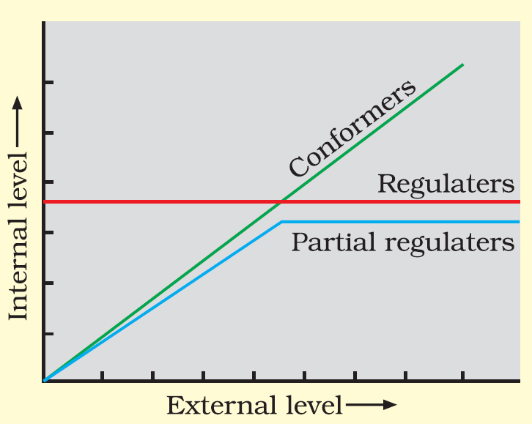
Figure Diagrammatic representation of organismic response

Slide 24
Responses to abiotic factors
During the course of evolution, the costs and benefits of maintaining a constant internal environment are taken into consideration.
Some species have evolved the ability to
regulate, but only over a limited range of environmental conditions, beyond which they simply conform.
If the stressful external conditions are localised or remain only for a short duration, the organism either
Migrate or
suspend
Notes:
During the course of millions of years of existence of organisms, many species would have evolved a relatively constant internal (within the body) environment that permits all biochemical reactions and physiological functions to proceed with maximal efficiency and thus, enhance the overall ‘fitness’ of the species.
Let us take an analogy to clarify this important concept. Suppose a person is able to perform his/ her best when the temperature is 25 ºC and wishes to maintain it so, even when it is scorchingly hot or freezingly cold outside. It could be achieved at home, in the car while travelling, and at workplace by using an air conditioner in summer and heater in winter. Then his/ her performance would be always maximal regardless of the weather around him/her. Here the person’s homeostasis is accomplished, not through physiological, but artificial means. How do other living organisms cope with the situation? Let us look at various possibilities

Slide 25
Organisms regulate in response to abiotic factors
Some organisms are able to maintain homeostasis by
physiological means and
behavioural means
Homeostasis is the process of maintaining constancy of organism's internal environment (optimal temperature and osmotic concentration of body fluids) despite varying external environmental conditions.
homeostasis ensures constant body temperature, constant osmotic concentration, etc.
All birds and mammals, and a very few lower vertebrate and invertebrate species are capable of such regulation (thermoregulation and osmoregulation).
Evolutionary biologists believe that the ‘success’ of mammals is largely due to their ability to maintain a constant body temperature and thrive whether they live in Antarctica or in the Sahara desert.
The mechanisms used by most mammals to regulate their body temperature are similar to the ones that we humans use.
We maintain a constant body temperature of 37 ºC in winter, summer and other seasons.
Notes:
In summer, when outside temperature is more than our body temperature, we sweat profusely. The resulting evaporative cooling, similar to what happens with a desert cooler in operation, brings down the body temperature. In winter when the temperature is much lower than 37 ºC, we start to shiver, a kind of exercise which produces heat and raises the body temperature. Plants, on the other hand, do not have such mechanisms to maintain internal temperatures.

Slide 26
Organisms conform in response to abiotic factors
An overwhelming majority (99 percent) of animals and nearly all plants change their body temperature changes with the ambient temperature as they cannot maintain a constant internal environment.
Conformers plants and animals (like aquatic animals) can change the osmotic concentration of the body fluids with that of the ambient water osmotic concentration.
Thermoregulation is energetically expensive for many organisms, particularly true for small animals like shrews and humming birds.
Notes:
Considering the benefits of a constant internal environment to the organism, we must ask why these conformers had not evolved to become regulators. Recall the human analogy we used above; much as they like, how many people can really afford an air conditioner? Many simply ‘sweat it out’ and resign themselves to suboptimal performance in hot summer months.

Slide 27
Organisms conform in response to abiotic factors
Heat loss or heat gain is a function of surface area.
Smaller the size of animals, larger the surface area [relative to their volume].
Suppose, surface area/volume in Human 10/15 and surface area/volume in humming bird =5/10, Calculate, compare and interpret which animal is having more surface area.
Surface area in Human 10/15 = 2/3 =0.6, 5/5 = 1 in humming bird
Surface area of humming bird > surface area in human
Example; You used to keep your food warm in basin rather than keeping in number of plates.
Since small animals have larger surface area, they tend to lose body heat very fast when it is cold outside; then they have to expend much energy to generate body heat through metabolism. (This is the main reason why very small animals are rarely found in polar regions).
Notes:
Considering the benefits of a constant internal environment to the organism, we must ask why these conformers had not evolved to become regulators. Recall the human analogy we used above; much as they like, how many people can really afford an air conditioner? Many simply ‘sweat it out’ and resign themselves to suboptimal performance in hot summer months.

Slide 28
Organisms migrate in response to abiotic factors
The organism can move away temporarily from the stressful habitat to a more hospitable area and return when stressful period is over. [like a person moving from Delhi to Shimla for the duration of summer]
Many animals, particularly birds, during winter undertake long-distance migrations to more hospitable areas.
Example: Every winter, birds from Siberia and other extremely cold northern regions immigrate to the famous Keolado National Park, Bhartpur, Rajasthan.
Notes:
The organism can move away temporarily from the stressful habitat to a more hospitable area and return when stressful period is over.
In human analogy, this strategy is like a person moving from Delhi to Shimla for the duration of summer.

Slide 29
Organisms suspend in response to abiotic factors
In bacteria, fungi and lower plants, various kinds of thick walled spores are formed which help them to survive unfavourable conditions – these germinate on availability of suitable environment.
In higher plants, seeds and other vegetative reproductive structures undergo dormancy stage over periods of stress, and they germinate to form new plants under favourable moisture and temperature conditions.
During dormancy, metabolic activities reduce.
If animals are unable to migrate, they might avoid the stress by escaping in time. For example;
bears going into hibernation during winter
Some snails and fish go into aestivation to avoid summer–related problems-heat and desiccation.
many zooplankton species in lakes and ponds enter diapause (a stage of suspended development) under unfavourable conditions

Slide 30
Adaptations
Adaptation is any attribute of the organism (morphological, physiological, behavioural) that enables the organism to survive and reproduce in its habitat.
Many adaptations have evolved over a long evolutionary time and are genetically fixed.
Adaptation in Kangaroo rat (Dipodomys merriami)
In the absence of an external source of water, the kangaroo rat in North American deserts is capable of meeting all its water requirements through
its internal fat oxidation (in which water is a by product) and
Concentration of urine and faeces (so that minimal volume of water is used to remove excretory products).
burrowing during day time
Notes:
Various alternatives available to organisms for coping with extremes in their environment
Some organisms are able to respond through certain physiological adjustments. Others organisms do so behaviourally (migrating temporarily to a less stressful habitat).

Slide 31
Adaptation in desert plants
To minimise water loss through transpiration, desert plants have a
thick cuticle on their leaf surfaces
stomata arranged in deep pits.
special photosynthetic pathway (CAM*) that enables their stomata to remain closed during day time.
Desert plants like Opuntia, have no leaves (leaves are reduced to spines) and the photosynthetic function is taken over by the flattened stems.
*Crassulacean Acid Metabolism
Notes:
Various alternatives available to organisms for coping with extremes in their environment
Some organisms are able to respond through certain physiological adjustments. Others organisms do so behaviourally (migrating temporarily to a less stressful habitat).

Slide 32
Adaptation in mammals in cold climate
Mammals from colder climates generally have shorter ears and limbs to minimise heat loss. (This is called the Allen’s Rule.)
Allen’s Rule is ecogeographical rule which states that significant differences exist in the size of limbs and other external organs of animals, even within the same species, depending on the geographical region in which they live.
Seals in the polar sea have blubber (thick layer of fat) below their skin that acts as an insulator and reduces loss of body heat.
Notes:
Some organisms possess adaptations that are physiological which allow them to respond quickly to a stressful situation.
If you had ever been to any high altitude place (>3,500m Rohtang Pass near Manali and Mansarovar, in China occupied Tibet) you must have experienced what is called altitude sickness. Its symptoms include nausea, fatigue and heart palpitations. This is because in the low atmospheric pressure of high altitudes, the body does not get enough oxygen. But, gradually you get acclimatised and stop experiencing altitude sickness. How did your body solve this problem? The body compensates low oxygen availability by increasing red blood cell production, decreasing the binding capacity of hemoglobin and by increasing breathing rate.
Many tribes live in the high altitude of Himalayas. Find out if they normally have a higher red blood cell count (or total hemoglobin) than people living in the plains.

Slide 33
Altitude sickness
Altitude sickness is illness caused by ascent to high altitude (>3,500 m like Rohtang Pass near Manali and Mansarovar, in China occupied Tibet
Symptoms of altitude sickness include;
nausea,
fatigue and
heart palpitations*.
Altitude sickness is suffered due to
low atmospheric pressure of high altitudes,
body does not get enough oxygen.
Altitude sickness problem is solved naturally by our body by
Compensating low oxygen availability by increasing red blood cell production,
decreasing the binding capacity of hemoglobin and
by increasing breathing rate.
*A rapid and irregular heart beat
Notes:
Some organisms possess adaptations that are physiological which allow them to respond quickly to a stressful situation.
If you had ever been to any high altitude place (>3,500m Rohtang Pass near Manali and Mansarovar, in China occupied Tibet) you must have experienced what is called altitude sickness. Its symptoms include nausea, fatigue and heart palpitations. This is because in the low atmospheric pressure of high altitudes, the body does not get enough oxygen. But, gradually you get acclimatised and stop experiencing altitude sickness. How did your body solve this problem? The body compensates low oxygen availability by increasing red blood cell production, decreasing the binding capacity of hemoglobin and by increasing breathing rate.
Many tribes live in the high altitude of Himalayas. Find out if they normally have a higher red blood cell count (or total hemoglobin) than people living in the plains.

Slide 34
Adaptation in human living at high altitude
People living at altitude
Compensate low oxygen availability by increasing red blood cell production,
decreasing the binding capacity of hemoglobin and
by increasing breathing rate.

Slide 35
Adaptations in desert lizard
Desert lizards manage to keep their body temperature fairly constant by behavioural means
By basking in the sun and absorb heat when their body temperature drops below the comfort zone,
move into shade when the ambient temperature starts increasing.
Some species are capable of burrowing into the soil to hide and escape from the above ground heat.
Notes:
Desert lizards lack the physiological ability that mammals have to deal with the high temperatures of their habitat,

Slide 36
Try to answer
How human are able to survive in different regions of the world?
How microbes (archaebacteria) flourish in hot springs and deep sea hydrothermal vents where temperatures far exceed 100 ºC?
How do fish thrive from freezing in antarctic waters where the temperature is always below zero?
How do marine invertebrates and fish live under crushing pressures*? (*>100 times the normal atmospheric pressure that we experience)
Notes:
In most animals, the metabolic reactions and the physiological functions proceed optimally in a narrow temperature range (in humans, it is – 37 ºC).
Microbes (archaebacteria) that flourish in hot springs and deep sea hydrothermal vents where temperatures far exceed 100 ºC.
Many fish thrive in Antarctic waters where the temperature is always below zero.
A large variety of marine invertebrates and fish live at great depths in the ocean where the pressure could be.
Organisms living in such extreme environments show a fascinating array of biochemical adaptations (presence of thermostable enzyme).
Some organisms show behavioural responses to cope with variations in their environment.

Slide 37
POPULATIONS

Slide 38
Population Attributes
A population has certain attributes that an individual organism does not.
The rates are expressed as change in numbers (increase or decrease) with respect to members of the population.
Examples for birth rate and death rate;
If in a pond there are 20 lotus plants last year and through reproduction 8 new plants are added, taking the current population to 28, we calculate the birth rate as
8/20 = 0.4 offspring per lotus per year.
If 4 individuals in a laboratory population of 40 fruit flies died during a week, the death rate in the population during that period is
4/40 = 0.1 individuals per fruit fly per week.
An individual organism | Population
may have births and deaths | Population has birth rates (in terms of per capita births) death rates (in terms of per capita deaths), and sex ratio (e.g., 60 % of the population are females and 40 % males)
Notes:
In nature, we rarely find isolated, single individuals of any species; majority of them live in groups in a well defined geographical area, share or compete for similar resources, potentially interbreed and thus constitute a population. Although the term interbreeding implies sexual reproduction, a group of individuals resulting from even asexual reproduction is also generally considered a population for the purpose of ecological studies. All the cormorants in a wetland, rats in an abandoned dwelling, teakwood trees in a forest tract, bacteria in a culture plate and lotus plants in a pond, are some examples of a population. In earlier chapters you have learnt that although an individual organism is the one that has to cope with a changed environment, it is at the population level that natural selection operates to evolve the desired traits. Population ecology is, therefore, an important area of ecology because it links ecology to population genetics and evolution.

Slide 39
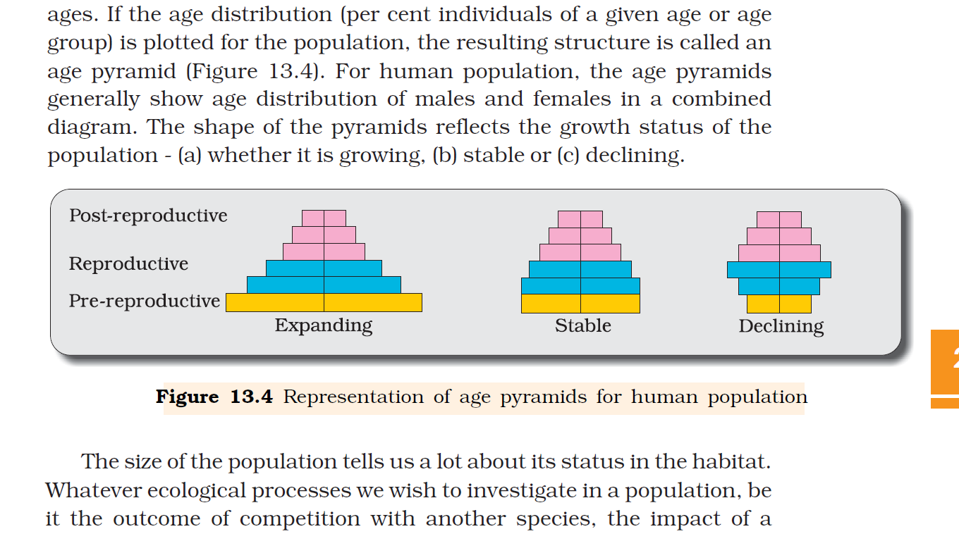
Population Attributes
A population at any given time is composed of individuals of different ages.
Age pyramid is the graphical representation or structure resulted by plotting age distribution for the population.
Age distribution is the percent individuals of a given age or age group
The shape of the pyramids reflects the growth status of the population
Figure Representation of age pyramids for human population
For human population, the age pyramids generally show age distribution of males and females in a combined diagram.
(Triangular shaped pyramid)
(Bell shaped pyramid)
(Urn shaped pyramid)

Slide 40
Population Attributes
A population at any given time is composed of individuals of different ages.
Age pyramid is the graphical representation or structure resulted by plotting age distribution for the population.
Age distribution is the percent individuals of a given age or age group
The shape of the pyramids reflects the growth status of the population
Figure Representation of age pyramids for human population
For human population, the age pyramids generally show age distribution of males and females in a combined diagram.
(Triangular shaped pyramid)
(Bell shaped pyramid)
(Urn shaped pyramid)

Slide 41
Population size/population density (N)
The size of the population tells us a lot about its status in the habitat.
Population size/population density (N) is the total number of individuals of a species in a specific geographical area, which can interbreed under natural conditions to produce fertile offsprings and function as a unit of biotic community of ecosystem.
The population size could be as low as <10 (Siberian cranes at Bharatpur wetlands in any year) or go into millions (Chlamydomonas in a pond).
Although total number is generally the most appropriate measure of population density, it is in some cases either meaningless or difficult to determine.
Total number of population is not an easily adoptable measure if the population is huge and counting is impossible or very time-consuming.

Slide 42
Determination of Population size/population density (N)
Absolute population densities
Relative population densities
Direct estimation
Indirect estimation
Counting by seeing the total number of population
Pug marks and fecal pellets based census of Tiger in National parks and tiger reserves
Most appropriate measure
Number of fish caught per trap
Impossible for huge population, difficult to determine or very time-consuming
Percent cover or biomass* (organic matter) total quantity or weight of organisms in a given area or volume

Slide 43
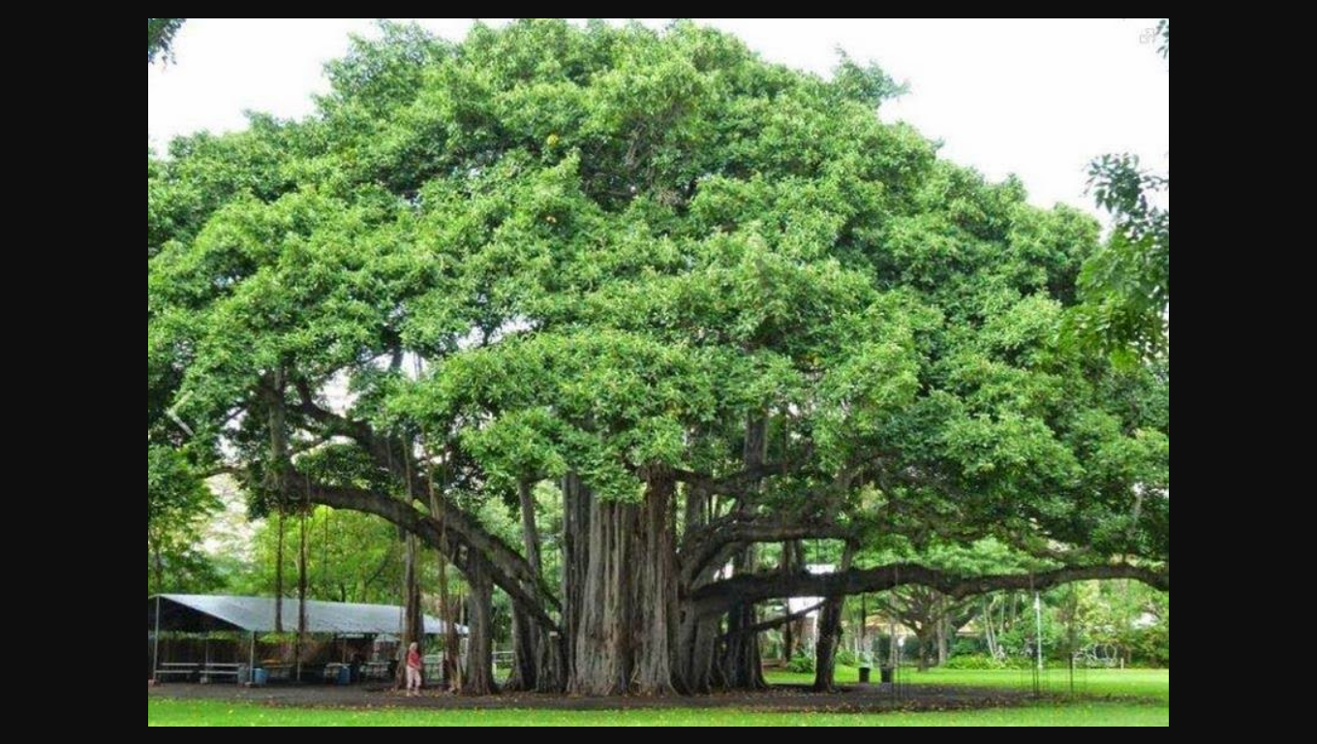
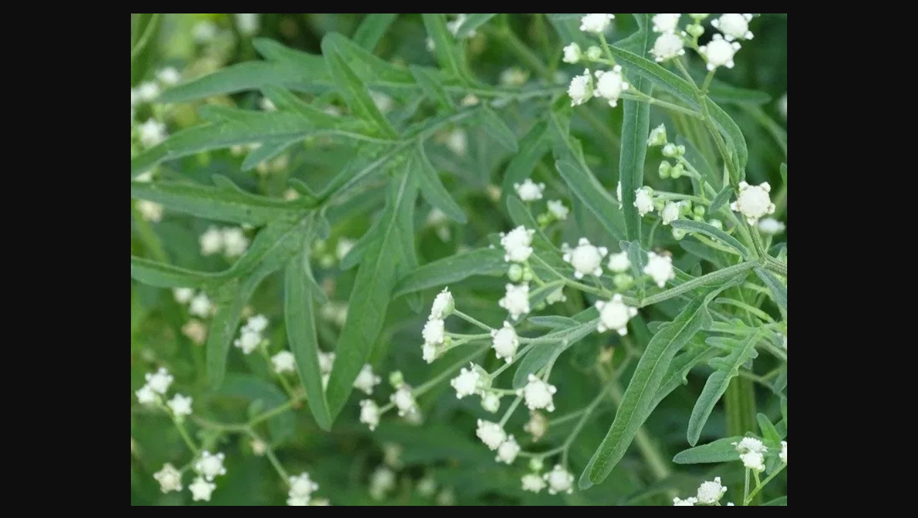
Population size is measured as percent cover or biomass* (organic matter)
200 Parthenium plants
*total quantity or weight of organisms in a given area or volume
Notes:
In an area, if there are 200 Parthenium plants but only a single huge banyan tree with a large canopy, stating that the population density of banyan is low relative to that of Parthenium amounts to underestimating the enormous role of the Banyan in that community. In such cases, the percent cover or biomass is a more meaningful measure of the population size.

Slide 44
Population size and its determination
If you have a dense laboratory culture of bacteria in a petri dish what is the best measure to report its density?
Sometimes, for certain ecological investigations, there is no need to know the absolute population densities; relative densities serve the purpose equally well. For instance, the number of fish caught per trap is good enough measure of its total population density in the lake.
Population sizes is estimated indirectly, without actually counting them or seeing them.
The tiger census in national parks and tiger reserves is often based on pug marks and fecal pellets.
Notes:
The size of the population tells us a lot about its status in the habitat.
Whatever ecological processes we wish to investigate in a population, be it the outcome of competition with another species, the impact of a predator or the effect of a pesticide application, we always evaluate them in terms of any change in the population size.
The size, in nature, could be as low as <10 (Siberian cranes at Bharatpur wetlands in any year) or go into millions (Chlamydomonas in a pond).
Population size, more technically called population density (designated as N), need not necessarily be measured in numbers only.
Although total number is generally the most appropriate measure of population density, it is in some cases either meaningless or difficult to determine. In an area, if there are 200 Parthenium plants but only a single huge banyan tree with a large canopy, stating that the population density of banyan is low relative to that of Parthenium amounts to underestimating the enormous role of the Banyan in that community. In such cases, the per cent cover or biomass is a more meaningful measure of the population size. Total number is again not an easily adoptable measure if the population is huge and counting is impossible or very time-consuming. If you have a dense laboratory culture of bacteria in a petri dish what is the best measure to report its density? Sometimes, for certain ecological investigations, there is no need to know the absolute population densities; relative densities serve the purpose equally well. For instance, the number of fish caught per trap is good enough measure of its total population density in the lake. We are mostly obliged to estimate population sizes indirectly, without actually counting them or seeing them. The tiger census in our national parks and tiger reserves is often based on pug marks and fecal pellets.
The size of the population tells us a lot about its status in the habitat.
Whatever ecological processes we wish to investigate in a population, be it the outcome of competition with another species, the impact of a predator or the effect of a pesticide application, we always evaluate them in terms of any change in the population size.
The size, in nature, could be as low as <10 (Siberian cranes at Bharatpur wetlands in any year) or go into millions (Chlamydomonas in a pond).
Population size, more technically called population density (designated as N), need not necessarily be measured in numbers only.
Although total number is generally the most appropriate measure of population density, it is in some cases either meaningless or difficult to determine. In an area, if there are 200 Parthenium plants but only a single huge banyan tree with a large canopy, stating that the population density of banyan is low relative to that of Parthenium amounts to underestimating the enormous role of the Banyan in that community. In such cases, the per cent cover or biomass is a more meaningful measure of the population size. Total number is again not an easily adoptable measure if the population is huge and counting is impossible or very time-consuming. If you have a dense laboratory culture of bacteria in a petri dish what is the best measure to report its density? Sometimes, for certain ecological investigations, there is no need to know the absolute population densities; relative densities serve the purpose equally well. For instance, the number of fish caught per trap is good enough measure of its total population density in the lake. We are mostly obliged to estimate population sizes indirectly, without actually counting them or seeing them. The tiger census in our national parks and tiger reserves is often based on pug marks and fecal pellets.

Slide 45
Population Growth
The size of a population for any species is not a static parameter as it keeps changing in time, depending on various factors including resources and food availability, predation pressure and weather conditions.
Changes in population density/populations size give us some idea of what is happening to the population – whether it is flourishing or declining.
Processes which fluctuates the density of a population in a given habitat during a given period are;
Natality
Mortality
Immigration
Emigration

Slide 46
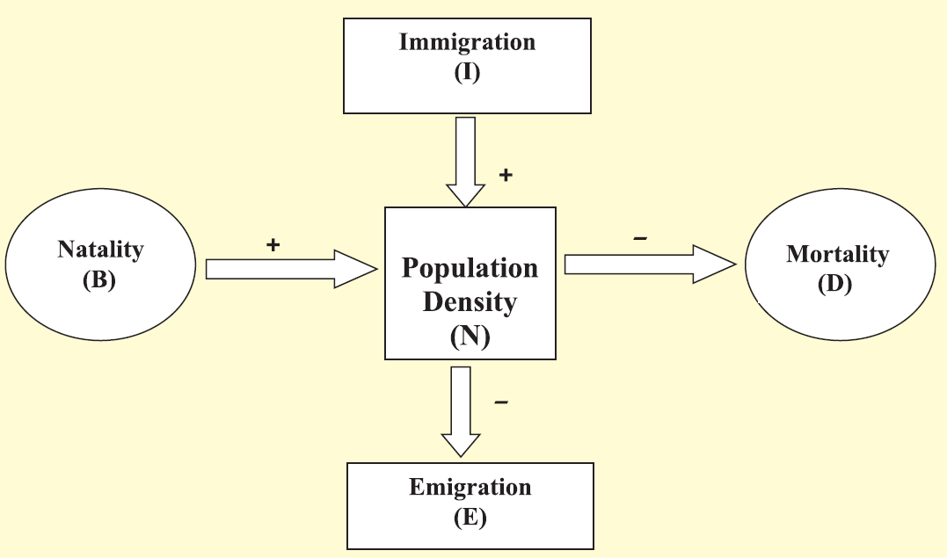
Population Growth
The population density (N) at time t+1 is
N_{t+1} = N_{t} + [(B + I) – (D + E)]
Where; N; population density at time t

Slide 47
Population Growth
Natality refers to the number of births during a given period in the population that are added to the initial density.
Mortality is the number of deaths in the population during a given period.
Immigration is the number of individuals of the same species that have come into the habitat from elsewhere during the time period under consideration.
Emigration is the number of individuals of the population who left the habitat and gone elsewhere during the time period under consideration.

Slide 48
Population Growth
The population density (N) at time t+1 is
N_{t+1} = N_{t} + [(B + I) – (D + E)]
Where; N; population density at time t
Population density will increase
if the number of births plus the number of immigrants (B + I) is more than the number of deaths plus the number of emigrants (D + E)
Population density will decrease
if the number of births plus the number of immigrants (B + I) is less than the number of deaths plus the number of emigrants (D + E)
Hence, births and deaths are the most important factors influencing population density.

Slide 49
Growth Models
Population growth models may be;
Exponential growth
Logistic growth
Notes:
Does the growth of a population with time show any specific and predictable pattern?
We have been concerned about unbridled human population growth and problems created by it in our country and it is therefore natural for us to be curious if different animal populations in nature behave the same way or show some restraints on growth. Perhaps we can learn a lesson or two from nature on how to control population growth.

Slide 50
Exponential growth
Resource (food and space) availability is obviously essential for the unimpeded growth of a population.
When resources in the habitat are unlimited, each species has the ability to realise fully its innate potential to grow in number in an exponential or geometric fashion, as Darwin observed while developing his theory of natural selection.

Slide 51
Exponential growth
Mathematical equation for exponential growth can be derived as follows;
dN/dt = (b – d) × N
Let (b–d) = r, then
dN/dt = rN
Where,
N: population of size
b: birth rates
d: death rates
r: intrinsic rate of natural increase
r is a very important parameter chosen for assessing impacts of any biotic or abiotic factor on population growth.

Slide 52
Exponential growth
The integral form of the exponential growth equation (dN/dt = rN) is as follows;
N_{t} = N₀ e^{rt}
Where,
N_{t} = Population density after time t
N₀ = Population density at time zero
r = intrinsic rate of natural increase
e = the base of natural logarithms (2.71828)
Notes:
Any species growing exponentially under unlimited resource conditions can reach enormous population densities in a short time. Darwin showed how even a slow growing animal like elephant could reach enormous numbers in the absence of checks. The following is an anecdote popularly narrated to demonstrate dramatically how fast a huge population could build up when growing exponentially.
The king and the minister sat for a chess game. The king, confident of winning the game, was ready to accept any bet proposed by the minister. The minister humbly said that if he won, he wanted only some wheat grains, the quantity of which is to be calculated by placing on the chess board one grain in Square 1, then two in Square 2, then four in Square 3, and eight in Square 4, and so on, doubling each time the previous quantity of wheat on the next square until all the 64 squares were filled. The king accepted the seemingly silly bet and started the game, but unluckily for him, the minister won. The king felt that fulfilling the minister’s bet was so easy. He started with a single grain on the first square and proceeded to fill the other squares following minister’s suggested procedure, but by the time he covered half the chess board, the king realised to his dismay that all the wheat produced in his entire kingdom pooled together would still be inadequate to cover all the 64 squares. Now think of a tiny Paramecium starting with just one individual and through binary fission, doubling in numbers every day, and imagine what a mindboggling population size it would reach in 64 days. (provided food and space remain unlimited)

Slide 53


Slide 54
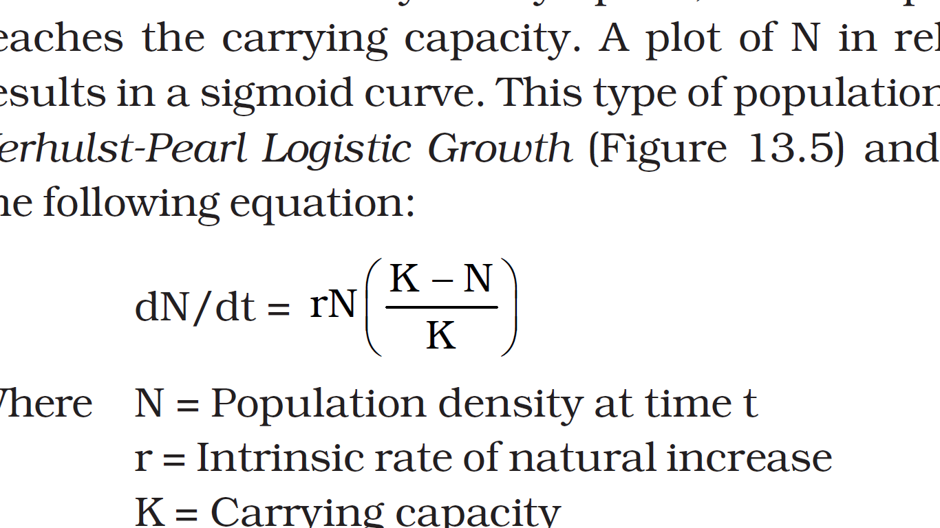
Logistic growth
Carrying capacity (K) is the attribute/ability of a given habitat to support a maximum possible number of individuals with its available resources.
A population growing in a habitat with limited resources show initially a lag phase, followed by phases of acceleration and deceleration and finally an asymptote (straight line) when the population density reaches the carrying capacity.
A plot of N in relation to time (t) results in a sigmoid curve. This type of population growth is called Verhulst-Pearl Logistic Growth and is described by the following equation:
dN/dt = K N rN (K-N/K)
Where,
N = Population density at time t ,
r = Intrinsic rate of natural increase,
K = Carrying capacity
Since resources for growth for most animal populations are finite and become limiting sooner or later, the logistic growth model is considered a more realistic one.

Slide 55
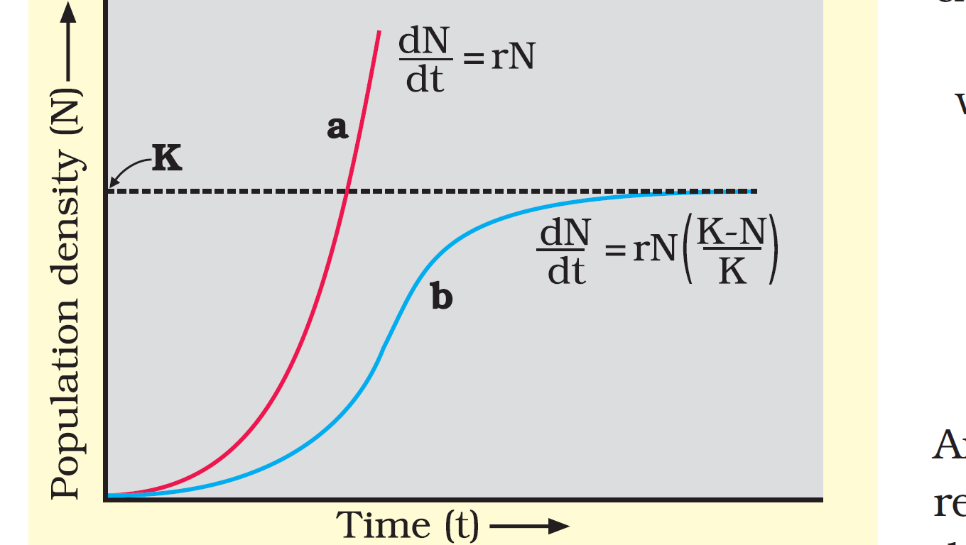
Population growth curve
The exponential or geometric growth pattern of a population results in a J-shaped curve when we plot N in relation to time.
Logistic growth curve is a sigmoid curve
Population growth curve;
a when resources are unlimiting the growth, plot is exponential,
b when resources are limiting the growth, plot is logistic.
K: carrying capacity
Notes:
To give you some idea about the magnitude of r values, for the Norway rat the r is 0.015, and for the flour beetle it is 0.12. In 1981, the r value for human population in India was 0.0205. Find out what the current r value is. For calculating it, you need to know the birth rates and death rates.
No population of any species in nature has its disposal unlimited resources to permit exponential growth. This leads to competition between individuals for limited resources. Eventually, the ‘fittest’ individual will survive and reproduce. The governments of many countries have also realised this fact and introduced various restraints with a view to limit human population growth.
In nature, a given habitat has enough resources to support a maximum possible number, beyond which no further growth is possible. Let us call this limit as nature’s carrying capacity (K) for that species in that habitat.
A population growing in a habitat with limited resources show initially a lag phase, followed by phases of acceleration and deceleration and finally an asymptote (straight line), when the population density reaches the carrying capacity. A plot of N in relation to time (t) results in a sigmoid curve. This type of population growth is called Verhulst-Pearl Logistic Growth (Figure 13.5) and is described by the following equation: dN/dt = K N rN (K-N/K)
Where N = Population density at time t , r = Intrinsic rate of natural increase, K = Carrying capacity
Since resources for growth for most animal populations are finite and become limiting sooner or later, the logistic growth model is considered a more realistic one. Gather from Government Census data the population figures for India for the last 100 years, plot them and check which growth pattern is evident.

Slide 56
Life History Variation
Populations evolve to maximise their reproductive fitness, also called Darwinian fitness (high r value), in the habitat in which they live.
Under a particular set of selection pressures, organisms evolve towards the most efficient reproductive strategy.
Some organisms breed only once in their lifetime (Pacific salmon fish, bamboo) while others breed many times during their lifetime (most birds and mammals).
Some produce a large number of small-sized offspring (Oysters, pelagic fishes) while others produce a small number of large-sized offspring (birds, mammals).
Ecologists suggest that life history traits of organisms have evolved in relation to the constraints imposed by the abiotic and biotic components of the habitat in which they live.
Evolution of life history traits in different species is currently an important area of research being conducted by ecologists.

Slide 57
Population Interactions

Slide 58
Population Interactions
There is no natural habitat on earth that is inhabited just by a single species.
For any species, the minimal requirement is one more species on which it can feed.
Even a plant species, which makes its own food, cannot survive alone; it needs soil microbes to break down the organic matter in soil and return the inorganic nutrients for absorption. And plant manage pollination with the help of animal agent.
It is obvious that in nature, animals, plants and microbes do not and cannot live in isolation but interact in various ways to form a biological community.
Even in minimal communities, many interactive linkages exist, although all may not be readily apparent.
Interspecific interactions arise from the interaction of populations of two different species.
Interspecific interaction could be beneficial, detrimental or neutral (neither harm nor benefit) to one of the species or both.

Slide 59
Table Population Interactions
Species A | Species B | Name of interspecific Interaction
+ | + | Mutualism
- | - | Competition
+ | - | Predation
+ | - | Parasitism
+ | 0 | Commensalism
- | 0 | Amensalism
+ beneficial interaction, - detrimental interaction, 0 neutral interaction

Slide 60
Population Interactions
Both the species benefit in mutualism in their interactions with each other
Both lose in competition in their interactions with each other.
In both parasitism and predation only one species benefits (parasite and predator, respectively) and the interaction is detrimental to the other species (host and prey, respectively).
Predation is a type of interaction in which an organism kills and feeds on another organism. The organism killing the other organism is known as the predator and the one which is killed is the prey. For example; predator (Tiger) kills and feeds its prey (deer).
The interaction where one species is benefitted and the other is neither benefitted nor harmed is called commensalism.
In amensalism, one species is harmed whereas the other is unaffected.
Predation, parasitism and commensalisms share a common characteristic -the interacting species live closely together.

Slide 61
Roles of predators
Acts as ‘conduits’ for energy transfer across trophic levels.
Control prey populations.
Help in maintaining species diversity in a community, by reducing the intensity of competition among competing prey species.

Slide 62
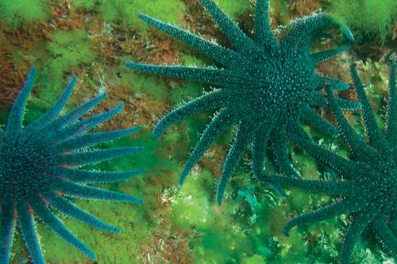
Experiment to show predator-prey inter-relationship
In the rocky intertidal communities of the American Pacific Coast, the starfish Pisaster is an important predator.
In an experiment, when all the starfish were removed, more than 10 species of invertebrates became extinct within a year, because of interspecific competition.
If a predator is too efficient and over exploits its prey, then the prey might become extinct following it, the predator will also become extinct for lack of food.
Figure Starfish Pisaster of American Pacific Coast

Slide 63
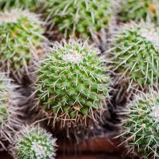
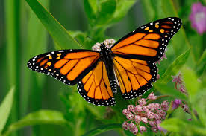
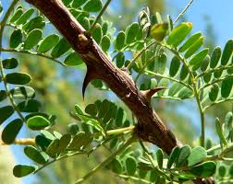
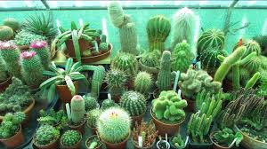
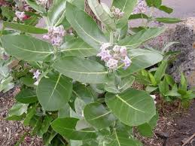
Adaptations developed by the prey
Some species of insects and frogs are cryptically colored (camouflaged) to avoid being detected easily by the predator.
The Monarch butterfly is highly distasteful to its predator (bird) because of a special chemical present in its body.
Presence of thorns in certain plant species (Acacia, Cactus).
Production and storage of toxic chemicals by plants.
Calotropis produces highly poisonous cardiac glycoside.
Nicotine, caffeine, quinine, strychnine, opium, etc., are produced by various plants.
Monarch butterfly
Cactus
Acacia
Calotropis

Slide 64
Adaptation by the Parasite
Loss of unnecessary sense organs
Presence of adhesive organs or suckers to cling on to the host
Loss of digestive system
High reproductive capacity

Slide 65
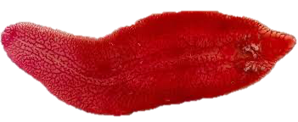
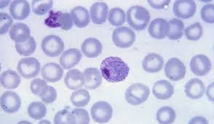
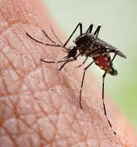
Parasitic life cycle involving one or two intermediate hosts
The human liver fluke depends on two intermediate hosts (a snail and a fish) to complete its life cycle.
The malaria parasite (Plasmodium) needs a vector (Mosquito) to complete its life cycle.
Human liver fluke
Figure Microscopic view of Plasmodium
Mosquito on human skin

Slide 66
Types of parasitism
Ectoparasites: Parasites that feed on the external surface of the host organism. Example: Lice on human, Tick on dogs, Cuscuta derives its nutrition from the host plant.
Endoparasites: These are parasites that live inside the host body at different sites (liver, kidney, lungs, red blood cells, etc.).
The life cycles of endoparasites are more complex because of their extreme specialization.
Examples: Tapeworm, Liver fluke, Plasmodium, Hookworm
Brood Parasitism
Observed in birds.
The parasitic bird lays its eggs in the nest of its host and lets the host incubate them.
The eggs of the parasitic bird have evolved to resemble the host’s egg in size and color to reduce the chances of the host bird detecting the foreign eggs and ejecting them from the nest.
Example; Cuckoo and crow

Slide 67
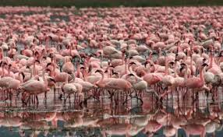
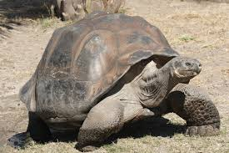
Competition
Competition occurs when closely related species compete for the same resources that are limiting.
In some shallow South American lakes visiting flamingoes and resident fishes compete for their common food, the zooplankton in the lake.
Resources always need not be limiting for competition to occur.
The feeding efficiency of one species might be reduced due to the interfering and inhibitory presence of the other species, even if resources (food and space) are abundant. Example: The Abingdon tortoise in Galapagos Islands became extinct within a decade after goats were introduced on the island, apparently due to the greater browsing efficiency of the goats.
Flamingoes of shallow South American lakes
Abingdon tortoise

Slide 68
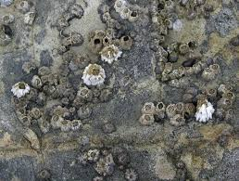
Competitive release
A species whose distribution is restricted to a small geographical area because of the presence of a competitively superior species is found to expand its distributional range dramatically when the competing species is experimentally removed.
Example: The larger and competitively superior Barnacle Balanus dominates the intertidal area and excludes the smaller Barnacle Chathamalus from that zone.
Competition is best defined as a process in which the fitness of one species (measured in terms of its ‘r’ the intrinsic rate of increase) is significantly lower in the presence of another species.
Barnacle Balanus and Barnacle Chthamalus

Slide 69
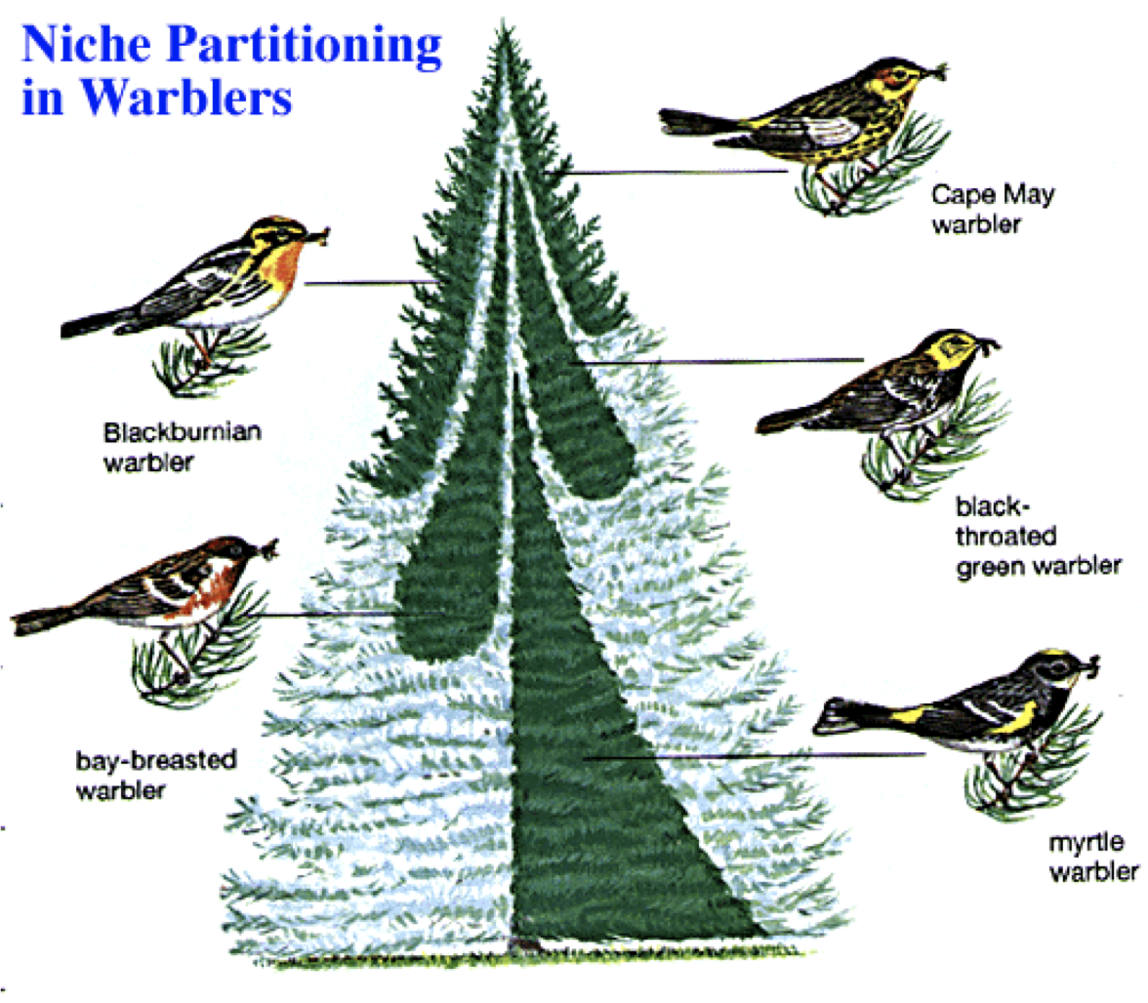
Gause’s Competitive Exclusion Principle
Two closely related species competing for the same resources cannot co-exist indefinitely and the competitively inferior one will be eliminated eventually.
Resource partitioning:
If two species compete for the same resource, they could avoid competition by choosing.
Different times for feeding or different foraging patterns.
Example; Five closely related species of warblers could live on the same tree and were able to avoid competition and co-exist due to behavioral differences in their foraging activities.

Slide 70
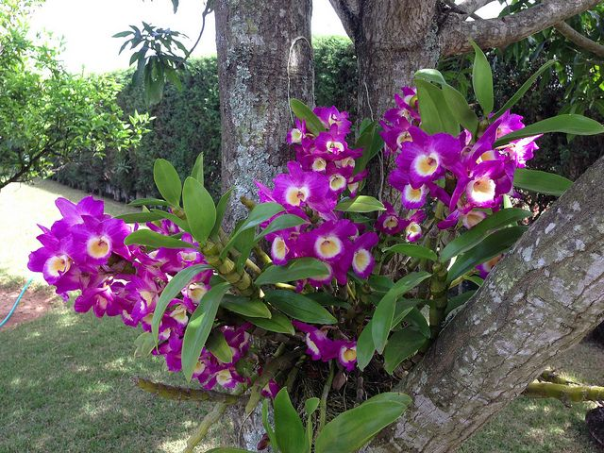
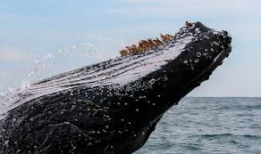
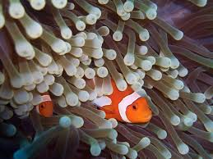
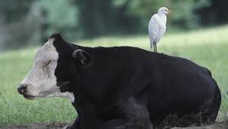
Commensalism
Commensalism is a kind of interaction one species benefits and the other is neither harmed nor benefited. Some of the examples are;
An orchid growing as an epiphyte on a mango branch
Barnacles growing on the back of a whale
The cattle egret and grazing cattle
The cattle egrets are benefitted by the cattle to detect insects because cattle stir up the bushes and insects gets flushed out from the vegetation, to be detected by the cattle egrets.
The Clownfish and Sea Anemone
The fish gets protection from predators which stay away from the stinging tentacles of the Sea Anemone.
*In the above examples, the mango tree, whale, cattle and Sea anemone neither of them derive any benefit by hosting other organisms, nor do they get any harm.
Orchid growing as an epiphyte on a mango branch
Barnacles growing on the back of a whale
Clownfish and Sea Anemone
Cattle egret and grazing cattle

Slide 71
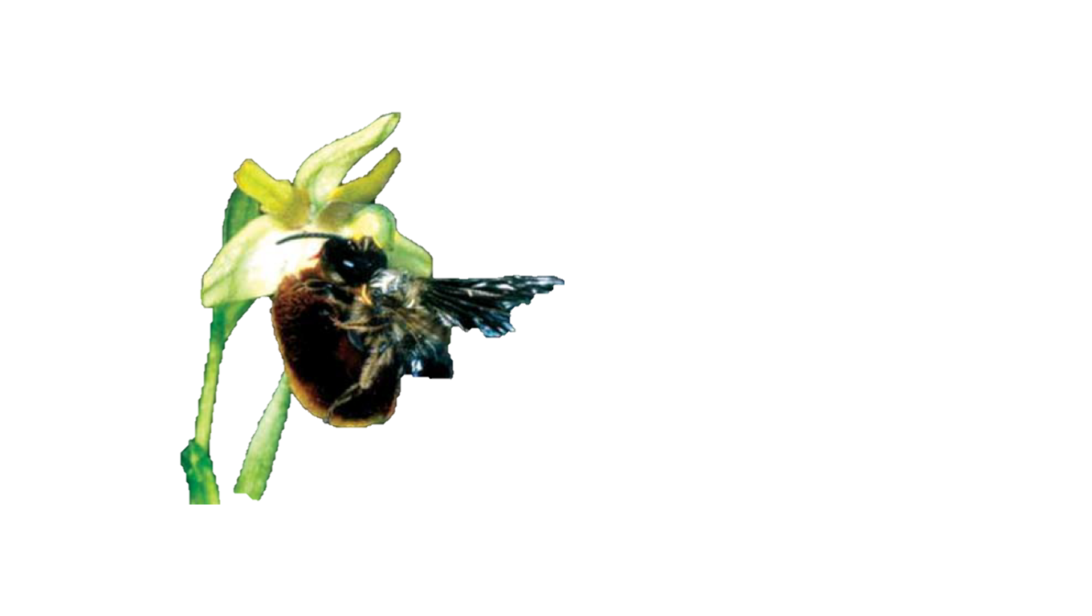
Mutualism
Mutualism is a kind of interaction both the interacting species derive benefits from each other. Some of the examples are as follow;
Lichens: An Intimate mutualistic relationship between a fungus and photosynthesising algae or cyanobacteria.
Mycorrhizae: Associations between fungi and the roots of higher plants.
Fungi help the plant in the absorption of essential nutrients from the soil.
The plant provides the fungi with energy-yielding carbohydrates.
Pollination:
Plants need the help of animals for pollinating their flowers and dispersing their seeds.
Plants offer rewards in the form of pollen and nectar for pollinators and juicy and nutritious fruits for seed dispersers
Figure Showing bee a pollinator on orchid flower

Slide 72
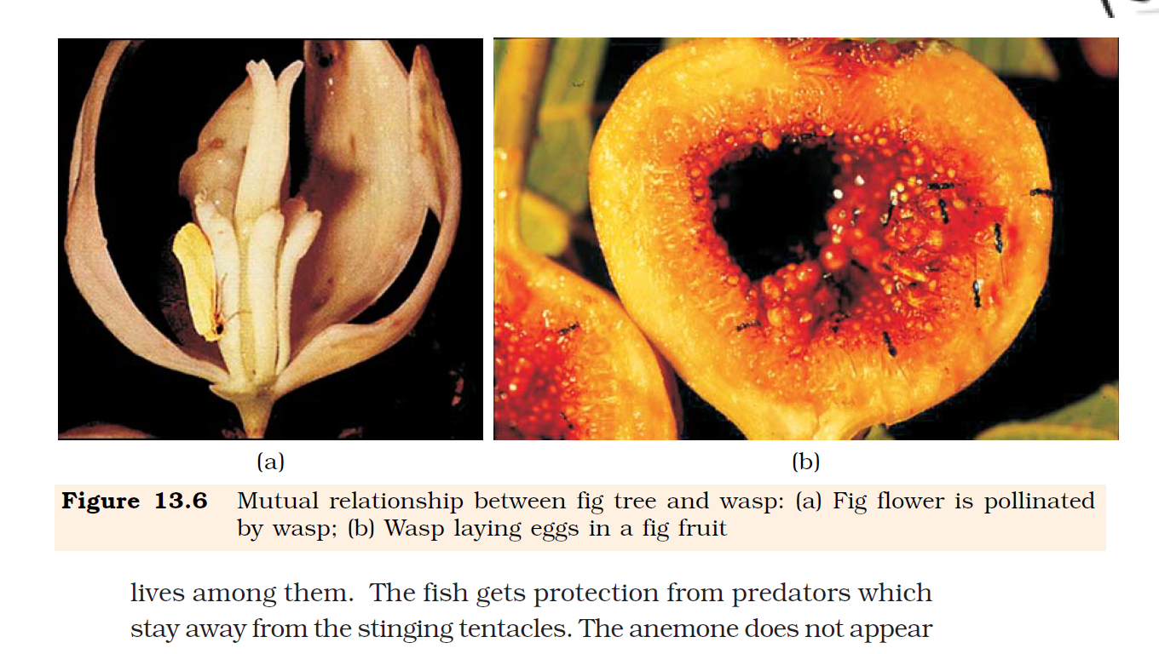
Co-evolution of Mutualists:
In many species of Fig trees, there is a tight one-to-one relationship with the pollinator species of wasp.
Fig species can be pollinated only by its ‘partner’ wasp species and no other species.
The wasp pollinates the fig inflorescence while searching for suitable egg-laying sites.
The female wasp uses the fruit not only as an oviposition (egg-laying) site but uses the developing seeds within the fruit for nourishing its larvae.
Fig flower is pollinate by wasp
Wasp laying eggs in a fig fruit

Slide 73
Pseudocopulation: (Co-evolution)
The Mediterranean orchid Ophrys employs ‘sexual deceit’ to get pollination done by a species of bee.
One petal of its flower bears an uncanny resemblance to the female of the bee in size, color, and markings.
The male bee is attracted to what it perceives as a female, ‘pseudocopulates’ with the flower, and during that process is dusted with pollen from the flower.
When this same bee psedocopulate with another flower, it transfers the pollen to it and thus pollinates.

Slide 74
Chapter Ends Here!

Slide 75

Teacher
Mr. Lhakpa Wangyal
PGT Biology
Email: lhakpawangyal@gmail.com
Contact number: 84497 99894
Social Baluni Public School

